Slide 1

AUTOMATIC FALL DETECTION CAVITY FOR ELDER PEOPLE USING MEMS SENSOR
By
PEDDITI SATVIKA(197R1A05N7)
PARANKUSHAM VAISHNAVI(197R1A05N8)
MAMINDLA MOUNIKA(197R1A05M7)
Under the Guidance of
DR.K.SRUJAN RAJU

Slide 2
ABSTRACT
Fall is dangerous, especially for elder people and patients. Elder people undergo the risk of serious harm due to fall. There may be absence of any safety system to detect fall. Thus, this proposed system gives a better solution for older people and patients and eases their lives.
The system uses tri axial accelerometer MEMS sensor mainly, which is fixed to the person's body. This is to detect the movements of the person by considering the values reckoned by the sensor.
When Person fall then MEMS detects and give signal to Arduino. Arduino displays status of MEMS on LCD display. Also Voice alert will come through APR module. Arduino sends fall detection status to IOT server through WIFI module.

Slide 3
EXISTING SYSTEM
Floor vibration based fall detection system consists of vibration-based floor detectors, using a piezoelectric sensor fixed to the floor surface of a room by means of a mass and spring arrangement.
Visual based fall detection system uses vision-based approach and multivariate exponentially weighted moving average (MEWMA) scheme to detect a fall. The user is monitored through installed cameras and a fall or not fall decision is made based on four major steps of the algorithm.
Smart textile based fall detection system uses the smart textile by Hexoskin, Carré technology, which enables real-time remote monitoring of 3D acceleration data using three-axis sensors, cardiac activity, and respiratory activity on smartphones and tablets using Bluetooth.

Slide 4
DISADVANTAGES
High false alarm rate due to frequent hand movement.
Device is unable to detect a user falling against a wall and falling end in sitting position.

Slide 5
PROPOSED SYSTEM
This system provides an alert to the care takers or other people about the fall occurrence of the elderly people or person who needs to be monitored.
Here micro controller is known as the heart of the entire system. In this system an MEMS Accelerometer is used, which will detect the fall of elderly person. The Accelerometer is able to measure the static acceleration and dynamic acceleration of gravity in sensing applications and shock or vibration respectively.
Here we have used the ADXL335 which is a 3-axis accelerometer sensor which has analog output with ±3g measurement range. It also has predetermined threshold axis values. If the acceleration of the body condition exceeds the threshold value, the system will recognize the fall condition.
On detecting the fall of the person, an intimation message can be sent through IOT module implemented with controller. Once the system is implemented, the care taker will get the user name and password for IOT data access.

Slide 6
ADVANTAGES
Immediate fall alert can be given.
Continuous Health condition monitoring system is available.
Alert message is given through IOT.
Date and time will be uploaded to cloud for future reference.

Slide 7
HARDWARE REQUIREMENTS
Microcontroller : Arduino Uno
Crystal : 16 MHz
LCD : 16X2 LCD
MEMS – Accelerometer : ADXL335/345
WIFI Module : ESP8266
Voice module : APR module
Power Source : 12V 1 amp Adaptor

Slide 8
SOFTWARE REQUIREMENTS
IDE: Arduino IDE
Languages: Embedded C, CPP

Slide 9
NOVELTY
Falling down is among the most common causes of medical attention required by the elderly people. Elderly people often injure themselves from falling down more especially when they are living alone. After a fall occurs, medical attention needs to be provided promptly in order to reduce the risk of victim.
This project proposed a fall detection system which is cost effective and reliable to detect fall and alert relatives for help and support. Moreover, this wearable device requires less implementation cost and provides a quick response.

Slide 10
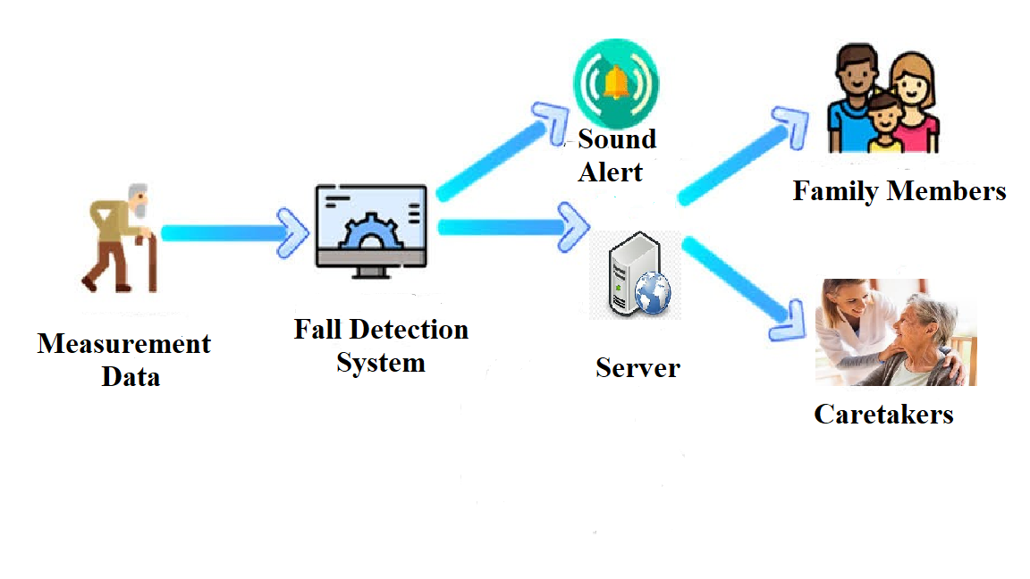
ARCHITECTURE

Slide 11
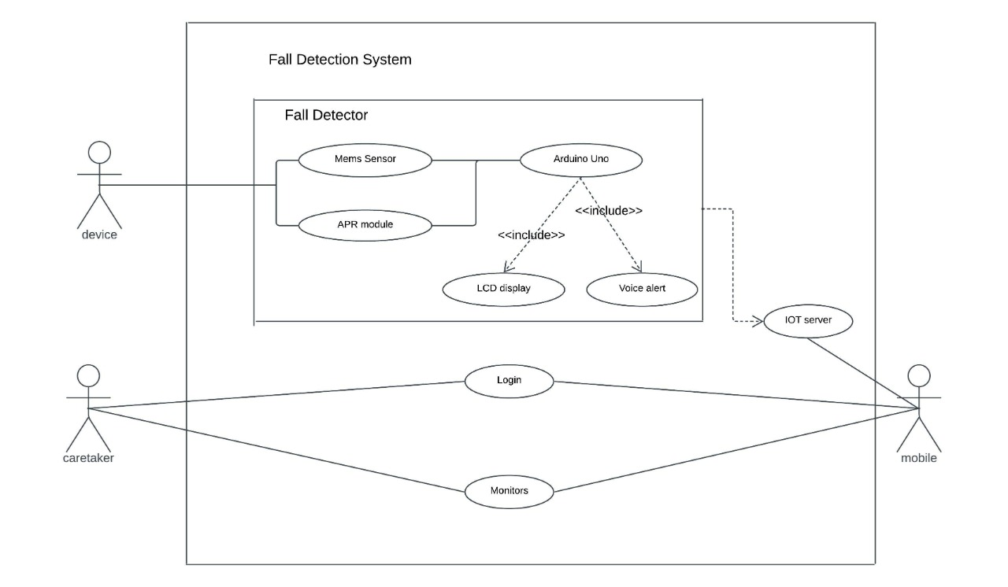
UML DIAGRAMS
USE CASE DIAGRAM
Use Case Diagram for Automatic fall detection cavity for elderly people using mems

Slide 12
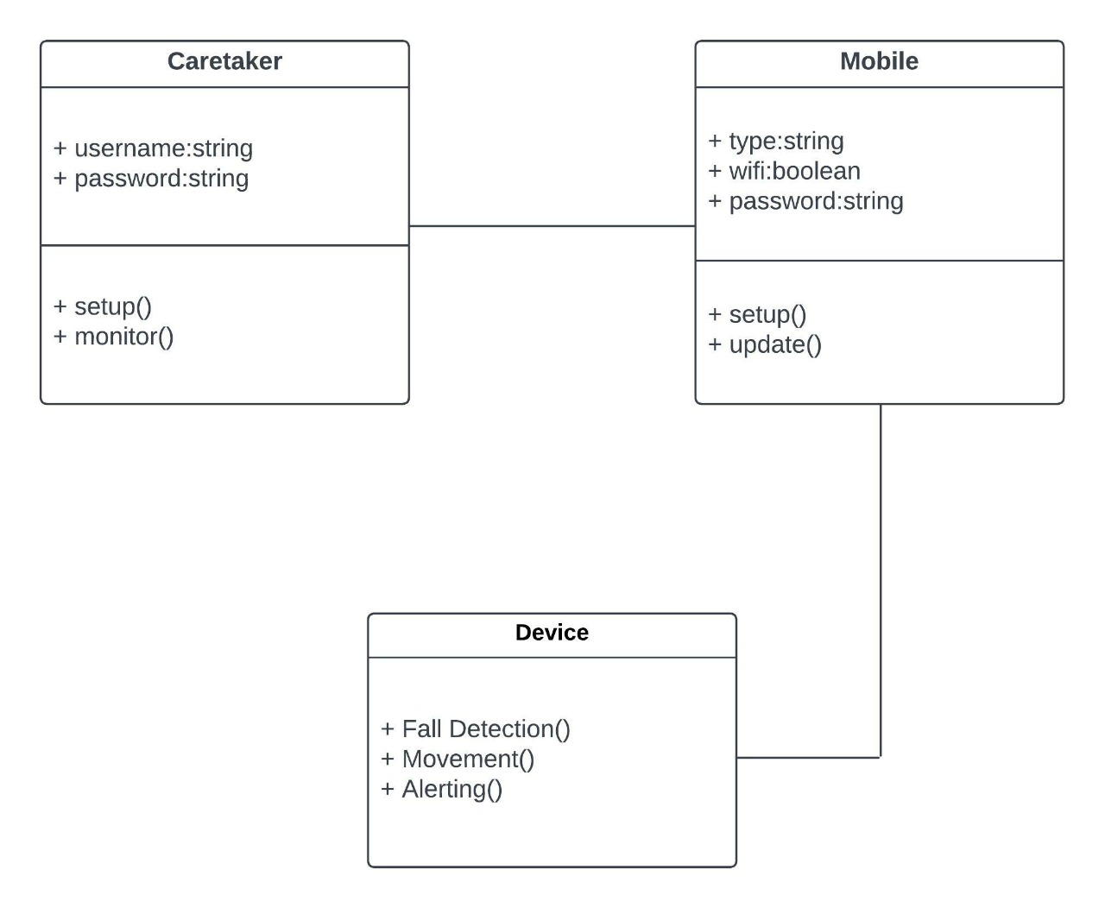
CLASS DIAGRAM
Class Diagram for Automatic fall detection cavity for elderly people using mems.

Slide 13
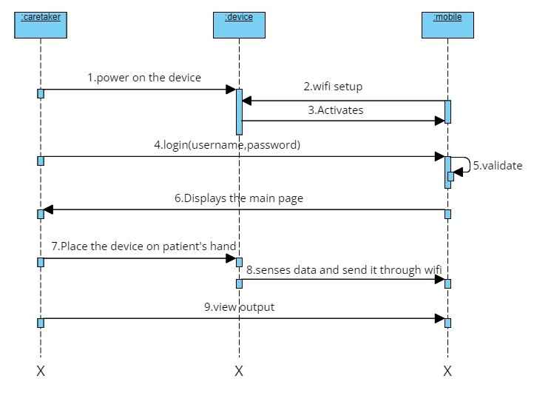
SEQUENCE DIAGRAM
Sequence Diagram for Automatic fall detection cavity for elderly people using mems

Slide 14
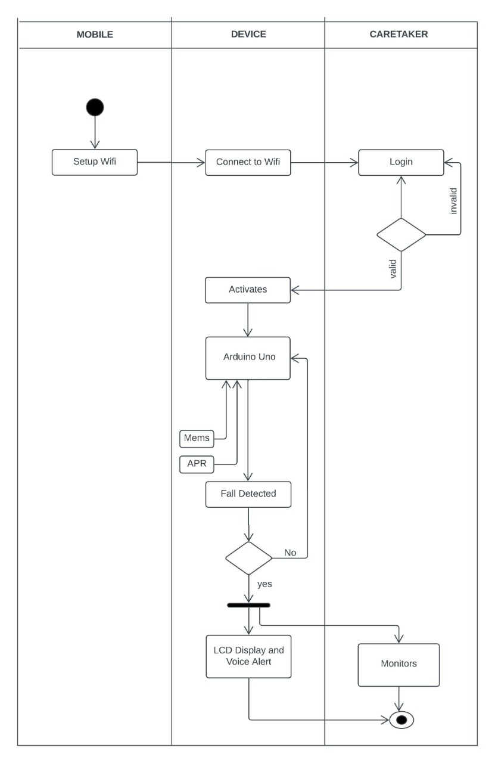
ACTIVITY DIAGRAM
Activity Diagram for Automatic fall detection cavity for elderly people using mems

Slide 15
SAMPLE CODE
#include <LiquidCrystal.h>
LiquidCrystal lcd(6,7,5,4,3,2);
#include <Wire.h>
#include <SoftwareSerial.h>
SoftwareSerial mySerial(8,9);
int ADXL345 = 0x53;
float X_out, Y_out, Z_out;
int memsx=0,memsy=0;
int voice1 = 10;
int voice2 = 11;
int voice3 = 12;
int voice4 = 13;

Slide 16
int buzzer = A3; char rcv,pastnumber[11]; char res[130]; void adxl_345_init() { Wire.begin(); // Initiate the Wire library // Set ADXL345 in measuring mode Wire.beginTransmission(ADXL345); // Start communicating with the device Wire.write(0x2D); // Access/ talk to POWER_CTL Register - 0x2D // Enable measurement Wire.write(8); // (8dec -> 0000 1000 binary) Bit D3 High for measuring enable Wire.endTransmission();

Slide 17
delay(10); } void adxl_345_read() { // === Read acceleromter data === // Wire.beginTransmission(ADXL345); Wire.write(0x32); // Start with register 0x32 (ACCEL_XOUT_H) Wire.endTransmission(false); Wire.requestFrom(ADXL345, 6, true); // Read 6 registers total, each axis value is stored in 2 registers X_out = ( Wire.read()| Wire.read() << 8); // X-axis value //X_out = X_out/256; //For a range of +-2g, we need to divide the raw values by 256, according to the datasheet

Slide 18
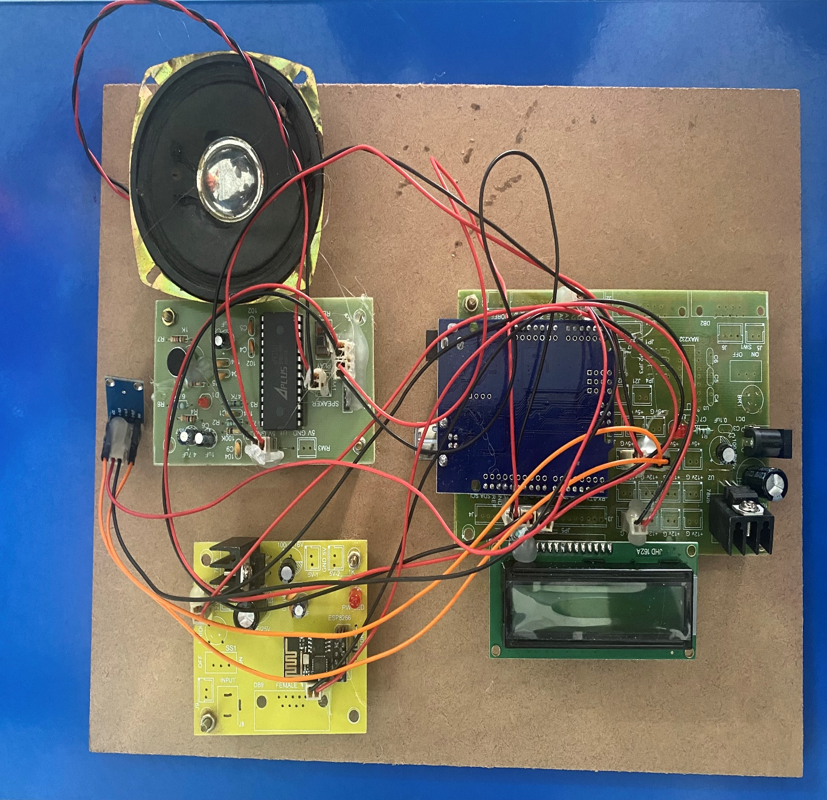
RESULTS
Automatic Fall Detection Device

Slide 19
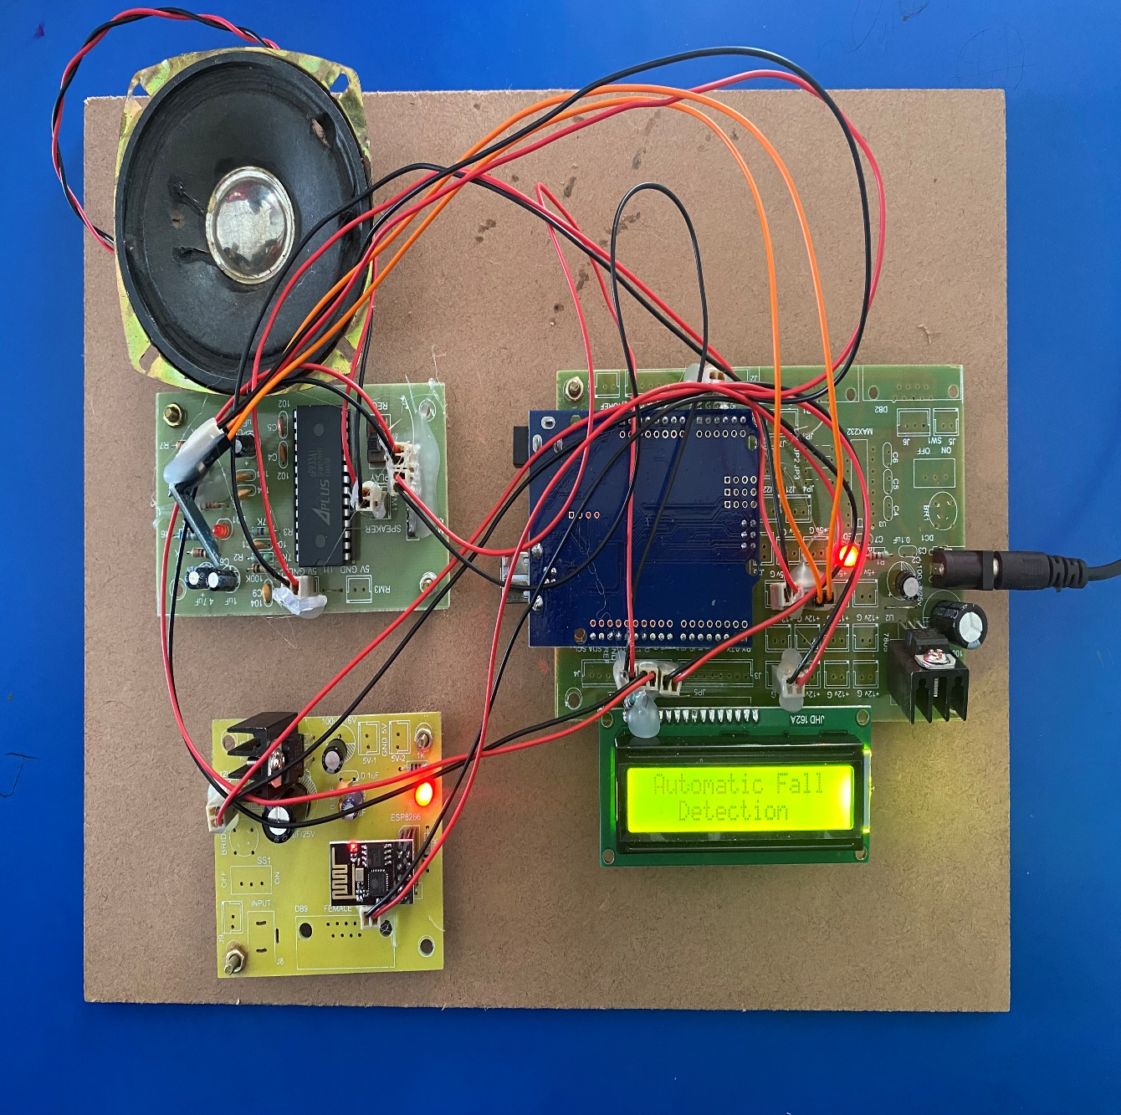
Switching on the power supply

Slide 20
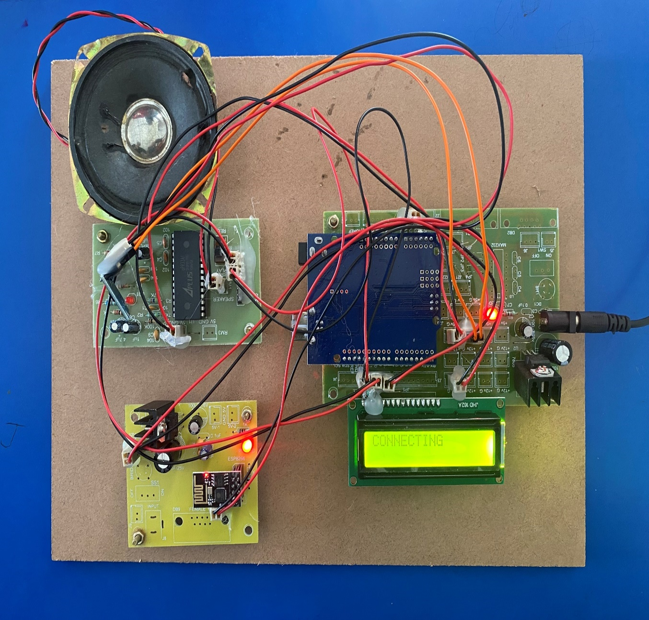
Connecting to wifi

Slide 21
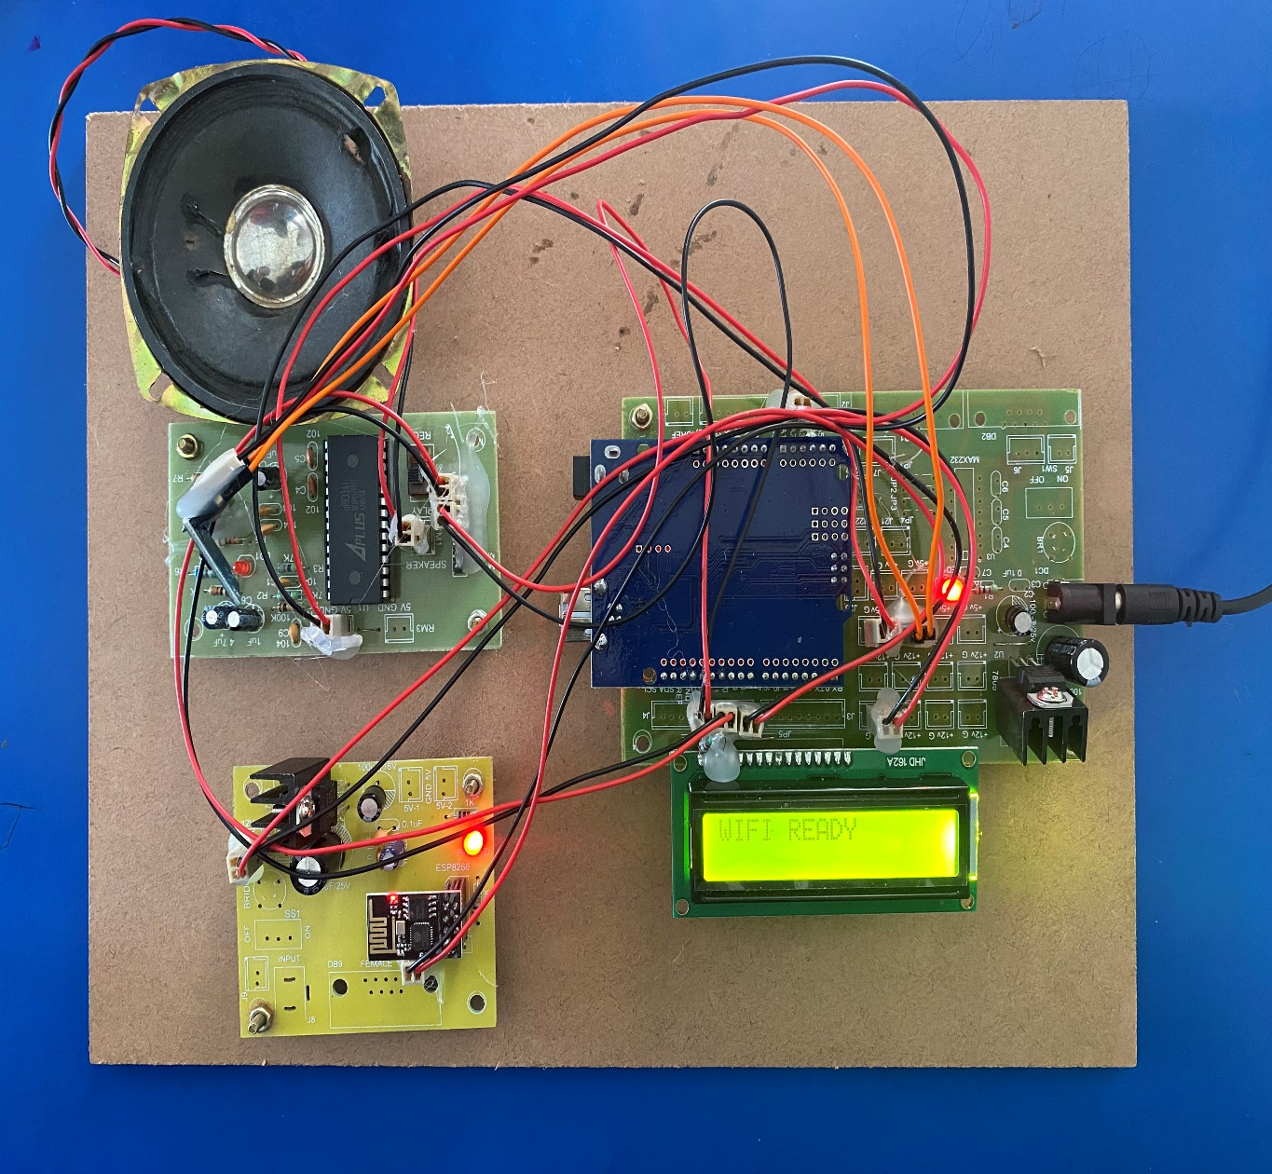
Device connected to wifi

Slide 22
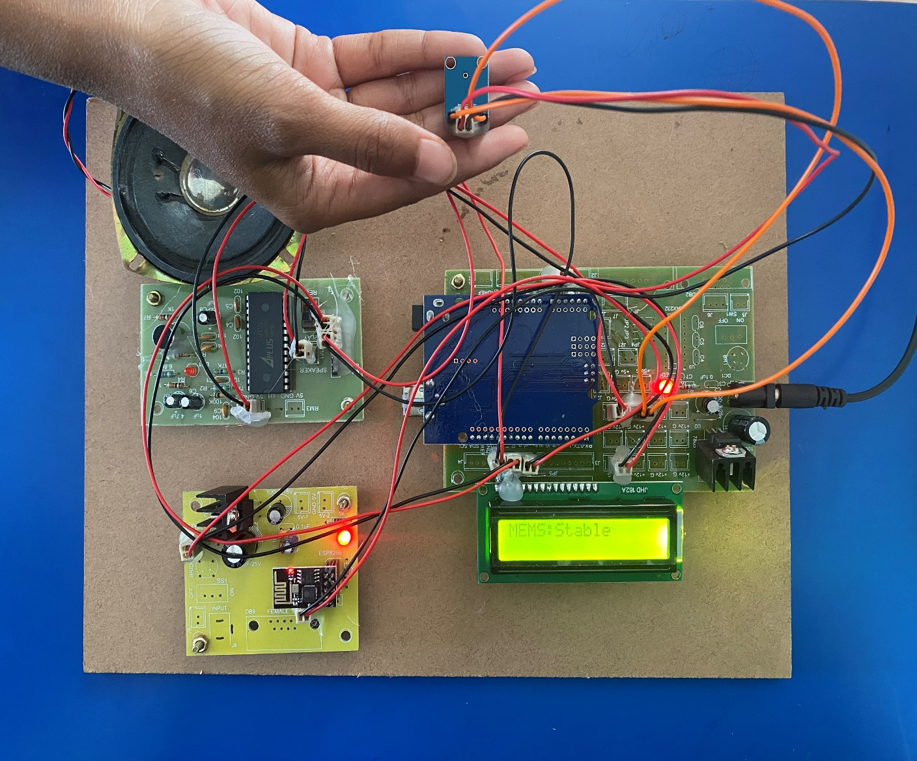
Device in stable condition

Slide 23
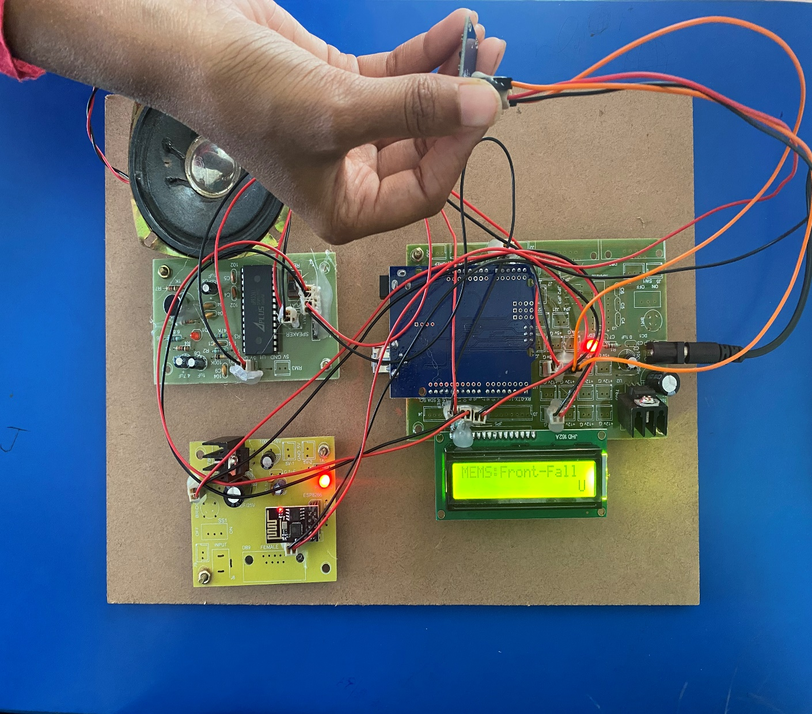
Front Fall Detected

Slide 24
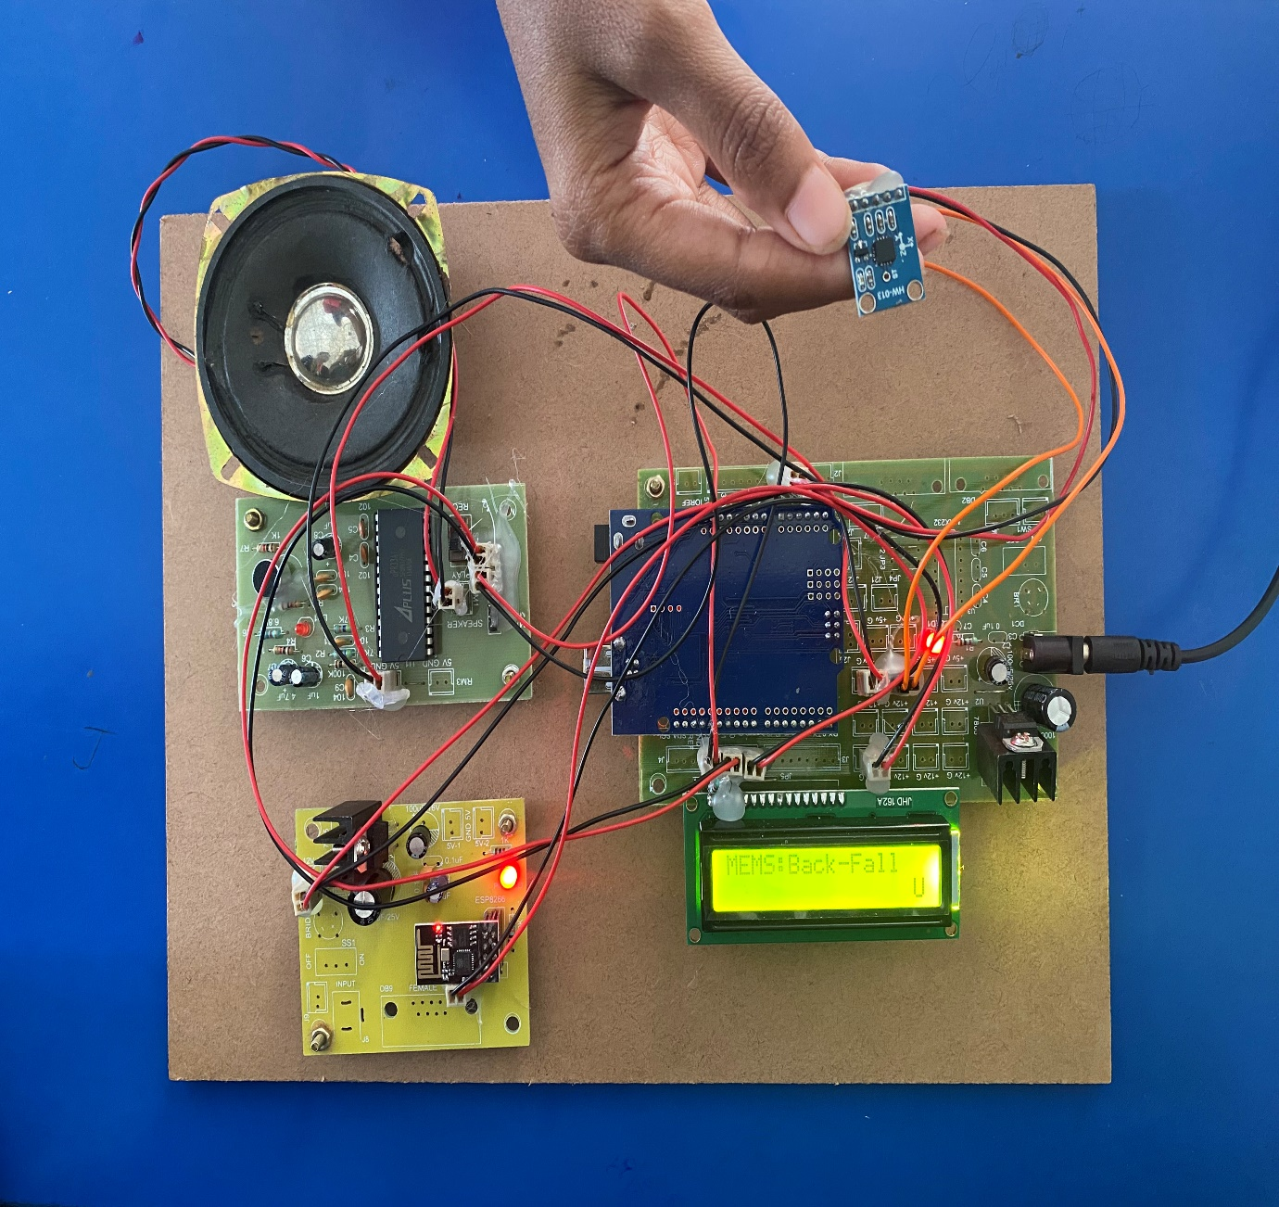
Back Fall Detected

Slide 25
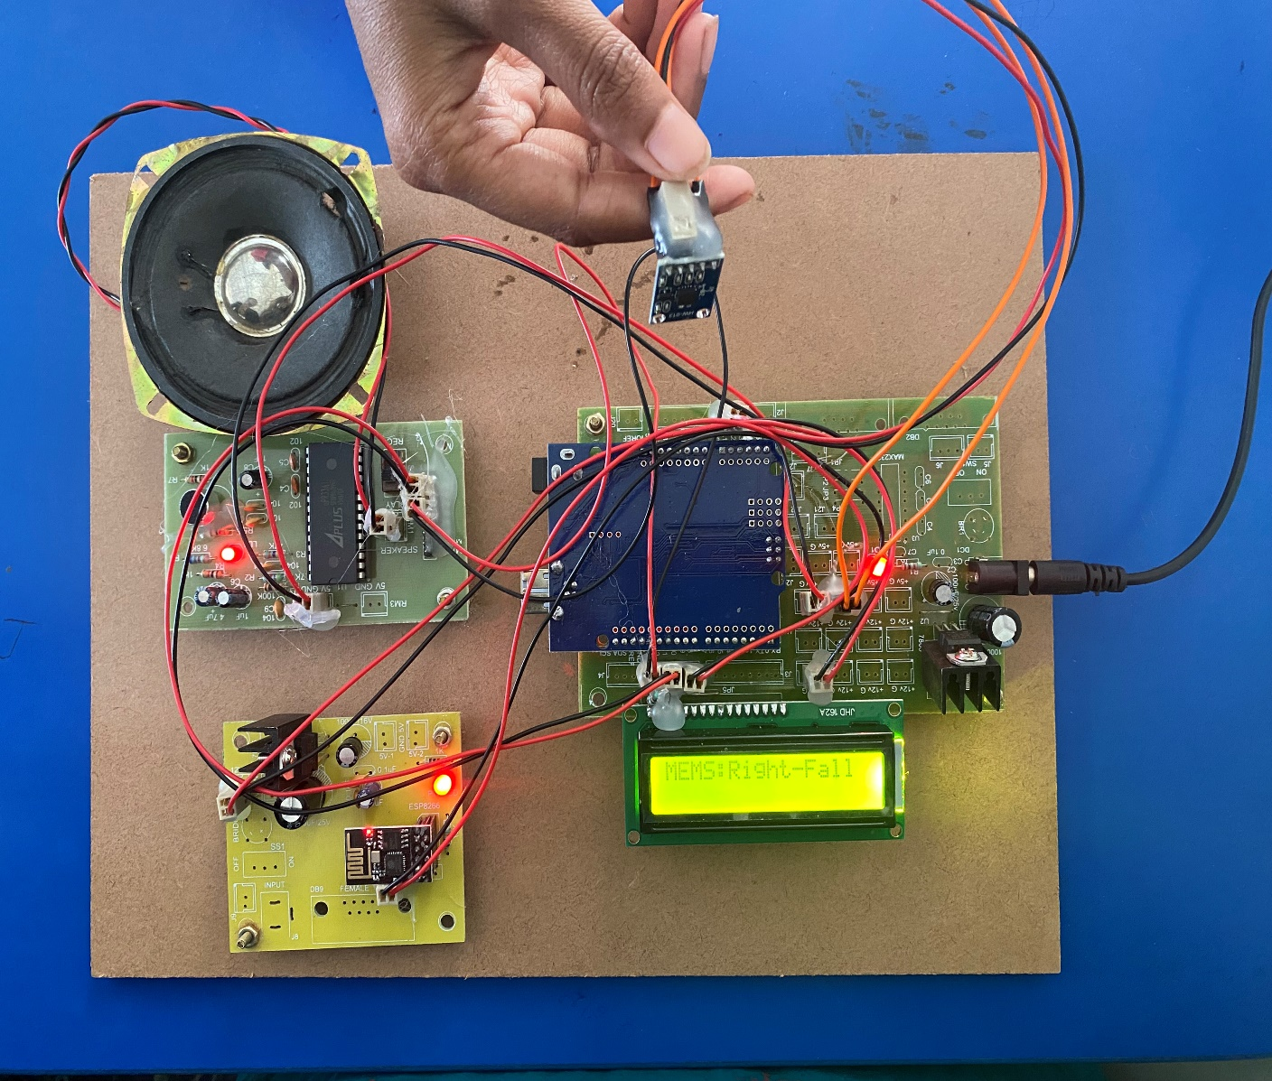
Right Fall Detected

Slide 26
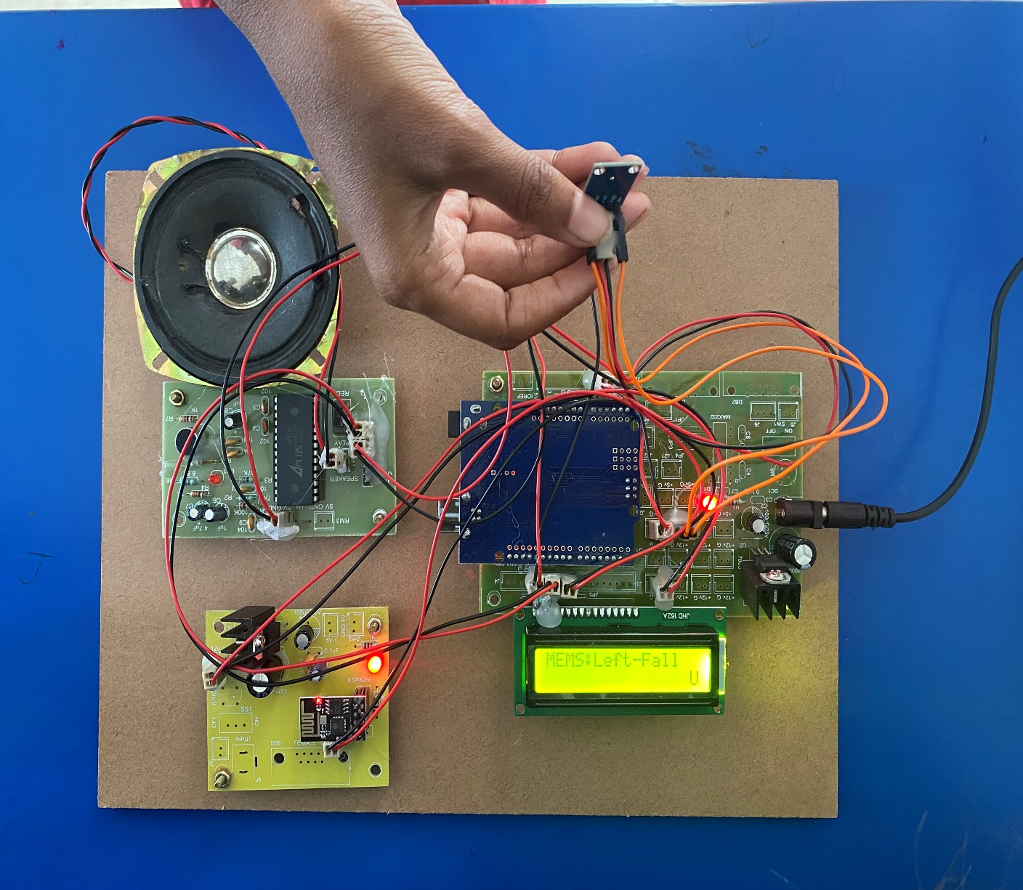
Left Fall Detected

Slide 27
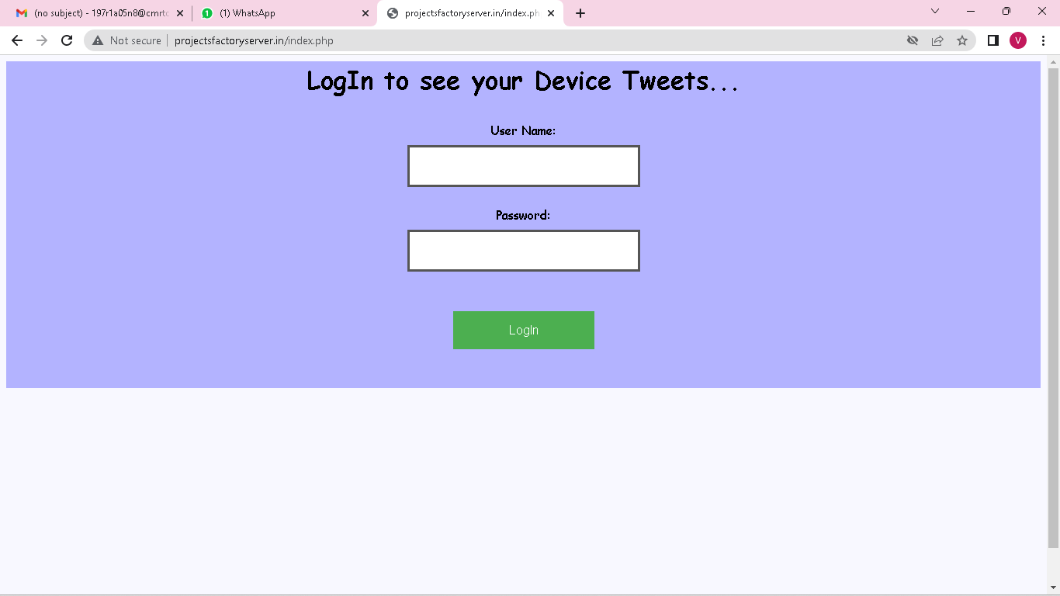
SCREENSHOTS
Login Page

Slide 28
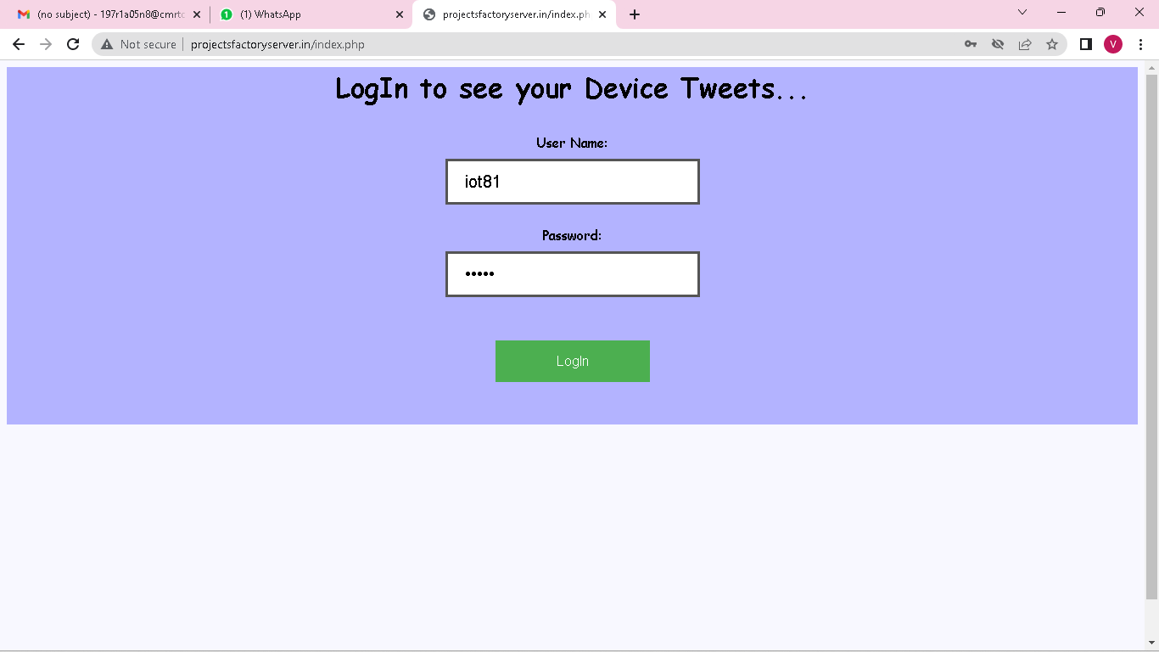
Entering Login Credentials

Slide 29
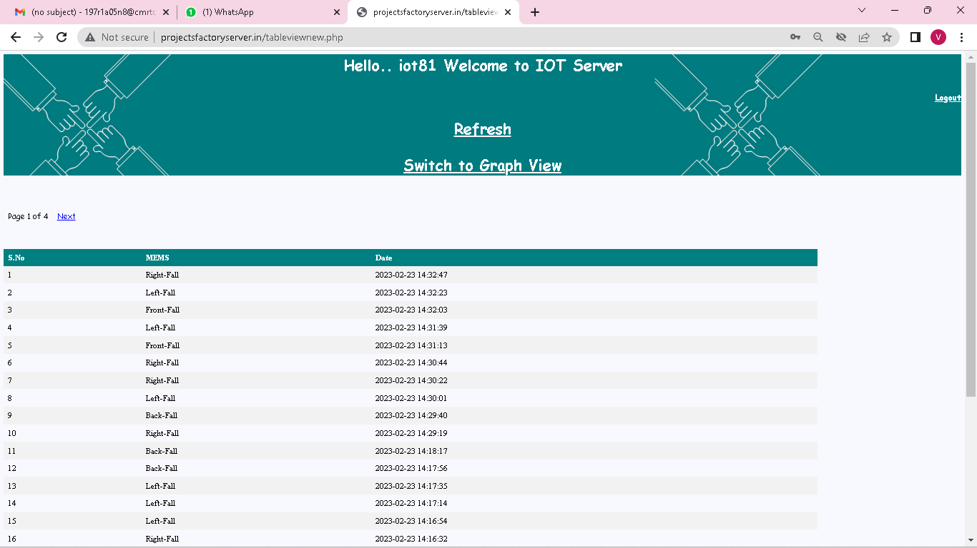
Iot Server Page

Slide 30
FUTURE ENHANCEMENTS
Manufacturers of fall Detection systems are integrating cutting-edge technologies into their devices such as GPS and Mobile Communication.
Furthermore, advancements in machine learning and Artificial Intelligence have expanded significantly in recent years, opening up a multitude of opportunities for Fall Detection System manufacturers to include products based on these technologies in their Product range.
Experts are working to improve AI and ML techniques because it provides improved Fall Detection rates, better monitoring.In the near future, technological advancements are expected to fuel the growth of Fall Detection System.

Slide 31
REFERENCES
[1] Hwang, J.Y., Kang, J.M., Jang, Y.W., Kim, H.C.: Development of novel algorithm and real time monitoring ambulatory system using Bluetooth module for fall detection in the elderly. In: Engineering in Medicine and Biology Society, IEMBS 2004, 26th Annual International Conference of the IEEE, vol. 1, pp. 2204–2207, September 2004
[2]2. B. Najafi, K. Aminian, F. Loew, Y. Blanc and P. A. Robert, "Measurement of stand-sit and sit-and transitions using a miniature gyroscope and its application in fall risk evaluation in the elderly", IEEE Trans. Biomed. Eng., vol. 49, no. 8, pp. 843-851, 2002.
[3]. National Institute ofNursing Research, Informal Caregiving Research for Chronic Conditions RFA, (2001).

Slide 32
CONCLUSION
As fall detection is considered to be the major challenge in domains like health care, especially in the cases of elder people, fall detection system has been developed based on IOT using MEMS .
The system is capable of continuous monitoring of the human body movement and these kinds of detection method uses some threshold value which is set with controller to detect a fall. Once the acceleration crosses the threshold value, the fall is detected and an alarm is generated.
The system consumes less power and has more efficient. This system is suitable for indoor as well as outdoor fall detection since both software as well as hardware are suitable for this purpose.

Slide 33
THANKYOU

